Slide 1





Opportunity for Phosphate Resource Upgrade
Jul 7th, 2025
0

Slide 2
Contents
01
Phosphorus Value Chain Outlook
02
Yellow Phosphorus
03
Value Up Opportunity for Phosphorus Resources

Slide 3

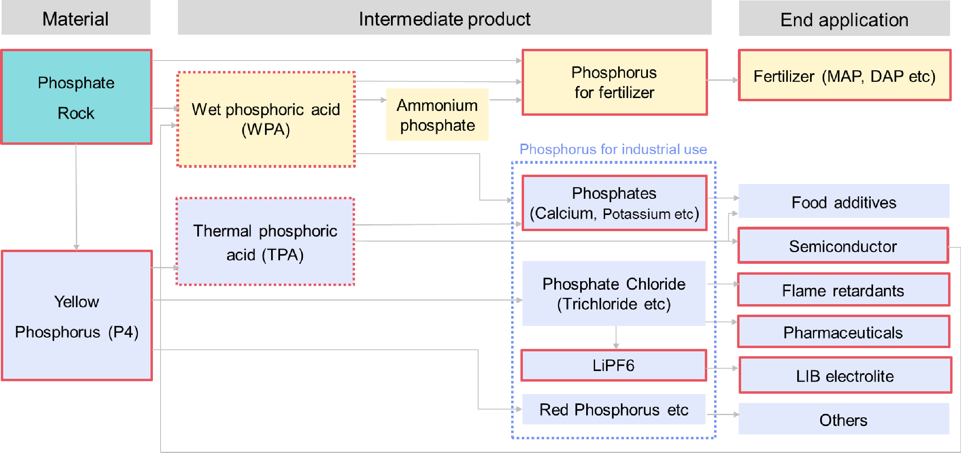
Related business in JPMC
Products/business handled
Products/business under development
JPMC have business from raw material to end application in phosphorus supply chain

Slide 4
Phosphorus Material Flow
Phosphate Rock
Floatation
Electricity / Cokes / SiO2 rock
High Purity Phosphate Rock
Yellow Phosphorus
High Purity P2O5
PCl3 / PCl5
Sulfuric Acid
SSP
Phosphoric Acid
Gypsum
High Purity Phosphoric Acid
TSP
NH3
MAP/DAP
Phosphorus Compounds
Phosphorus Compounds
Process |  | Wet Process |  |  | Dry Process
Demand Ratio |  | 90% |  |  | 10%
Application |  | Fertilizer |  |  | Semi-Con, LIB Electrolyte, Food Additive, Flame Retardant, Pharmaceuticals, etc
Market Size |  | Huge |  |  | 1.5mil MT ($5.0B) / 0.3mil MT ($1.0B)
1
3

Slide 5
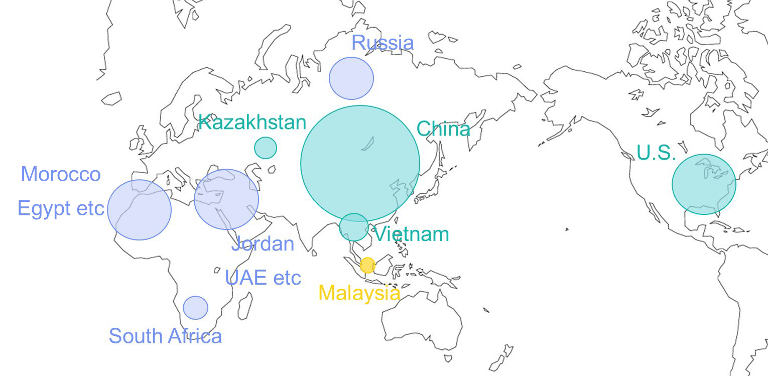
Yellow Phosphate (P4) in global market
Global Offshore Trade (2022)
US 9%
Others 32%
IND 23%
250kmt
$900m
VN
Export 44%
Import
DEU 16%
KZ 39%
KOR
^{6%} POL
10%
JPN 13%
Total Global Supply / Demand : 1.5mil MT
Global Offshore Market : 0.3mil MT
Expected Market Growth: 5-7% p.a , driven by Semi-Con, Food industries
Supply Sources for Global Market : KAZ and VN only
EU listed Phosphorus as “Critical Raw Materials“ in 2020
JPN listed Phosphorus as “Raw Material of Critical Products for Semi-Conductor Industries” in 2023
・・・Phosphate Rock & P4 ●・・・Phosphate Rock ●・・・P4
Country | Manufacturers |  | Capacity | Note
China | <100 |  | 900kMT | Restriction for Export
U.S. | 1 (Bayer) |  | 150kMT | Restriction for Export
Vietnam | 5 |  | 150kMT | Mainly to India, Japan
Kazakhstan | 1 (Kazphos) |  | 100kMT | Mainly to Europe
Malaysia | 1 (MPAS) |  | 50kMT | Under commissioning
Market requires new sustainable supply sources

Slide 6
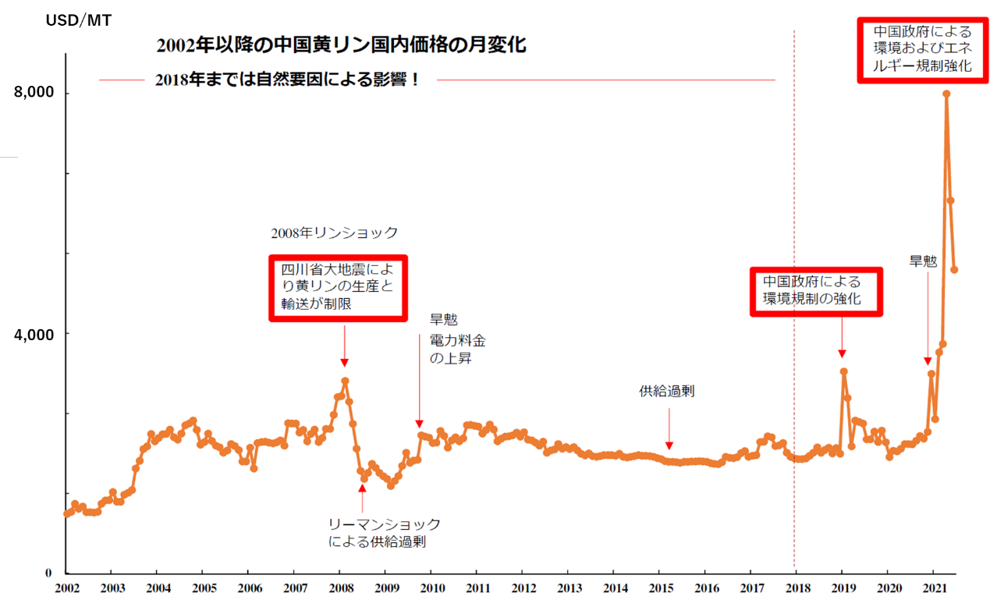
Historical P4 price trend
P4 history have repeated “export regulation by supplying country” ⇒ “find and secure new supply source”.
Phosphorus shock | Background
1st (1996) | Export regulation by U.S.
2nd (2008) | Limited production & logistics due to the earthquake in China and then export regulation (100% export tax)
3rd (2021) | Environmental regulation (power cut) in China and then market price soaring Vietnam supplier’s price (< $3,000/mt ➔ $8,000/mt ➔ $4,000/mt)
3rd shock (2021)
P4 Chinese market price trend from 2002
2nd shock (2008)
Environmental regulation enhanced by China

Slide 7
Difficulties in Yellow Phosphate (P4)
CO2 Emission
Reduction Process ➔ High Electricity Consumption
CHN Government restricts P4 production in CHN
Resources
X
Low Cost Electricity X
Technologies Engineering
X
Marketing Safe Handling
Production Technology
Operational Technology are in CHN, VN, KZ
EPC in CHN
Quality Verification
Rather Strict Quality Requirement for Food Additive, Pharma and Semi-Con industries.
Handling
Highly Flammable

